Slide 1
Computer Vision (VO, 911.908, Winter term 22/23)
Roland Kwitt
Department of Artificial Intelligence and Human Interfaces (AIHI)
University of Salzburg, Austria

Slide 2
Schedule for today
Logistics
Resources
What is computer vision?
Some typical computer vision problems

Slide 3
Logistics
E-Mail: Roland [dot] Kwitt [at] plus [dot] ac [dot] at
Course material: available online at http://rkwitt.org (→ Teaching)

Slide 4
Logistics
Grading
1 final exam at the end of the course (see course website for details)

Slide 5
Resources
PyTorch (most recent version v1.12.1)
https://pytorch.org/
scikit-learn (Python)
http://scikit-learn.org/stable/
scikit-image (Python)
http://scikit-image.org

Slide 6
Resources
“Deep Learning”
Goodfellow, Bengio, Courville
http://www.deeplearningbook.org/
Please check the course website for updates on relevant research papers.

Slide 7
Resources
Throughout the lecture, we will primarily cover “modern” approaches to computer vision, using (deep) neural networks.
However, I still do want to mention a “classic” vision book which is definitely worth reading.
“Computer Vision: Algorithms and Applications”
R., Szeliski, 2010
http://szeliski.org/Book/

Slide 8
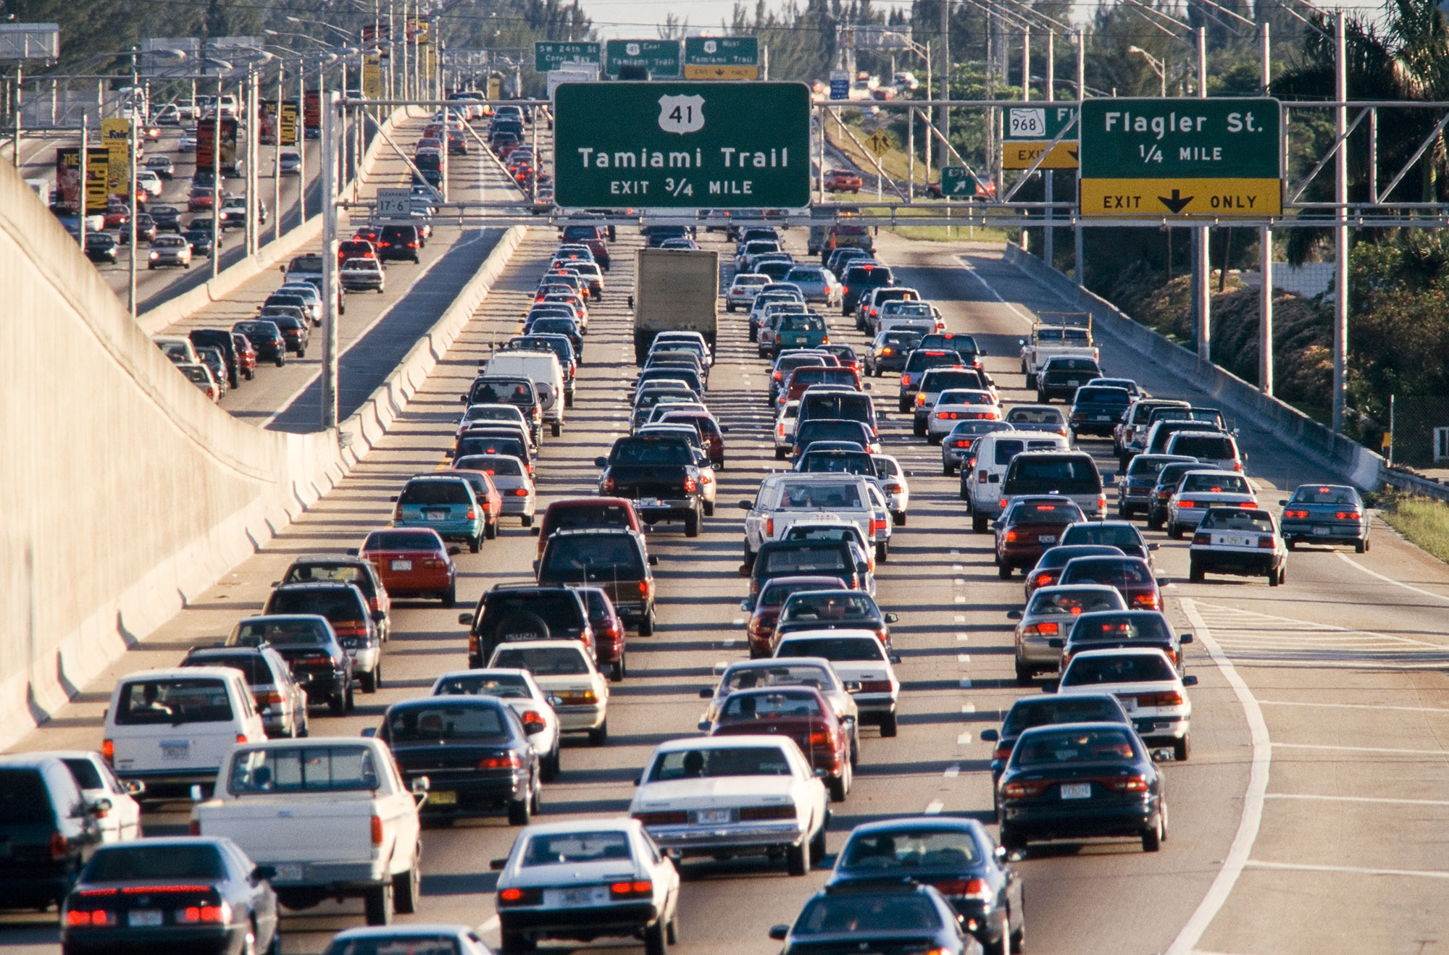
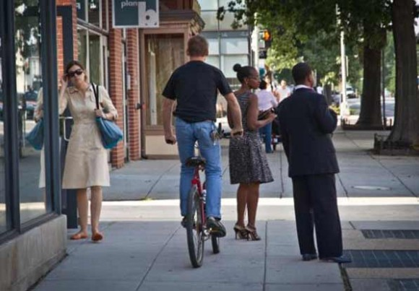
What is computer vision?
Courtesy of Szeliski
(Luiz Gomez Photos)
The human visual system (HVS) is remarkably good at so many tasks, e.g.,
- detecting people & object’s
- perceiving translucency, shape, color (see figure on the left),
- counting people & vehicles (see middle figure)
- recognizing scenes, etc.

Slide 9
What is computer vision?
Remarkable fact:
A substantial fraction of the macaque’s total cortical area is devoted to vision (approx. 15% according to [Hubel, “Eye, Brain and Vision”] )

Slide 10
What is computer vision?
We want to build systems for automatic understanding of images/videos.
This includes, but is not limited to,
1) inferring properties of the 3D world (measurement)
2) enabling recognition of objects, people, scenes, etc. (perception)
3) mining, searching and interacting with visual data (search / organization)
Slide adapted from Kristen Grauman, “Introduction to Computer Vision”

Slide 11
What is computer vision?
Graphics
Image Processing
Artificial Intelligence
Computer Vision
Machine Learning
Cognitive Science
Slide adapted from Kristen Grauman, “Introduction to Computer Vision”

Slide 12
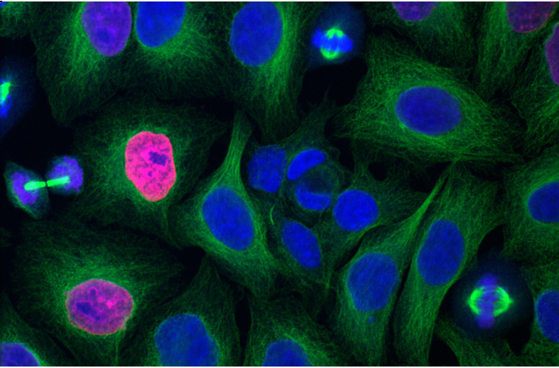
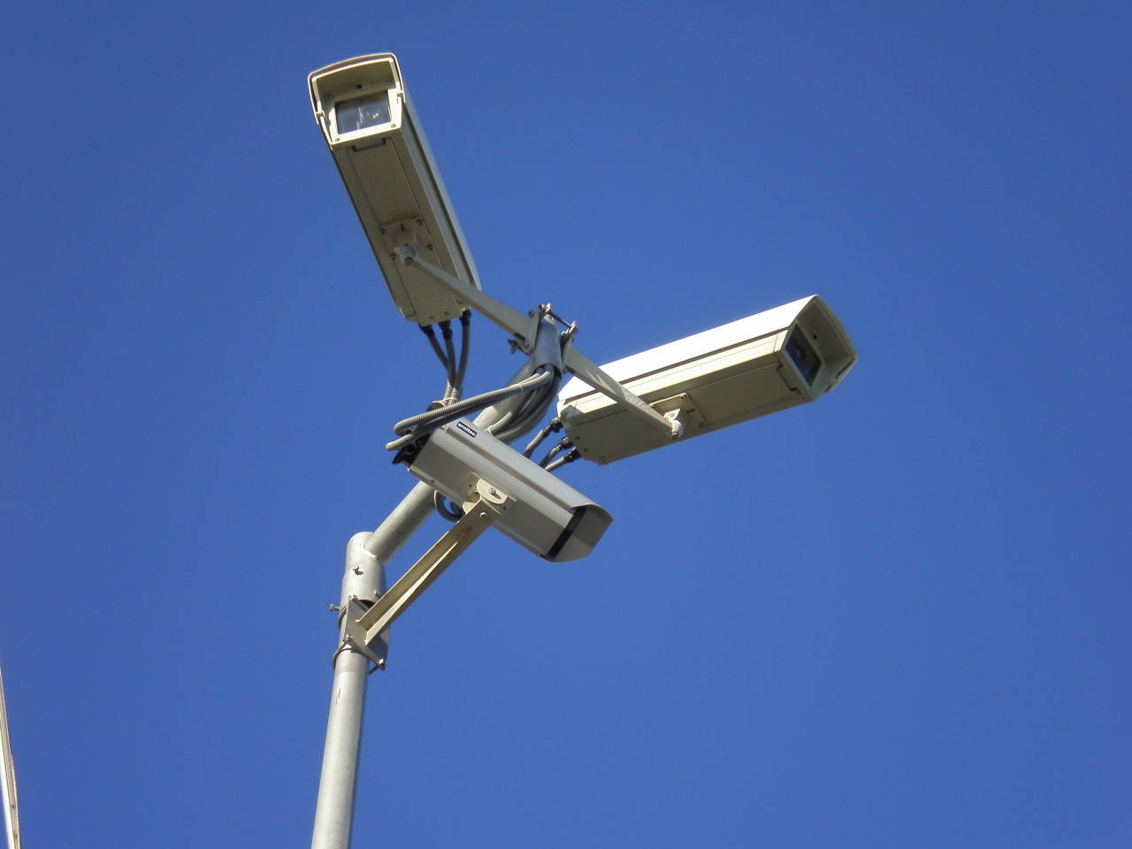
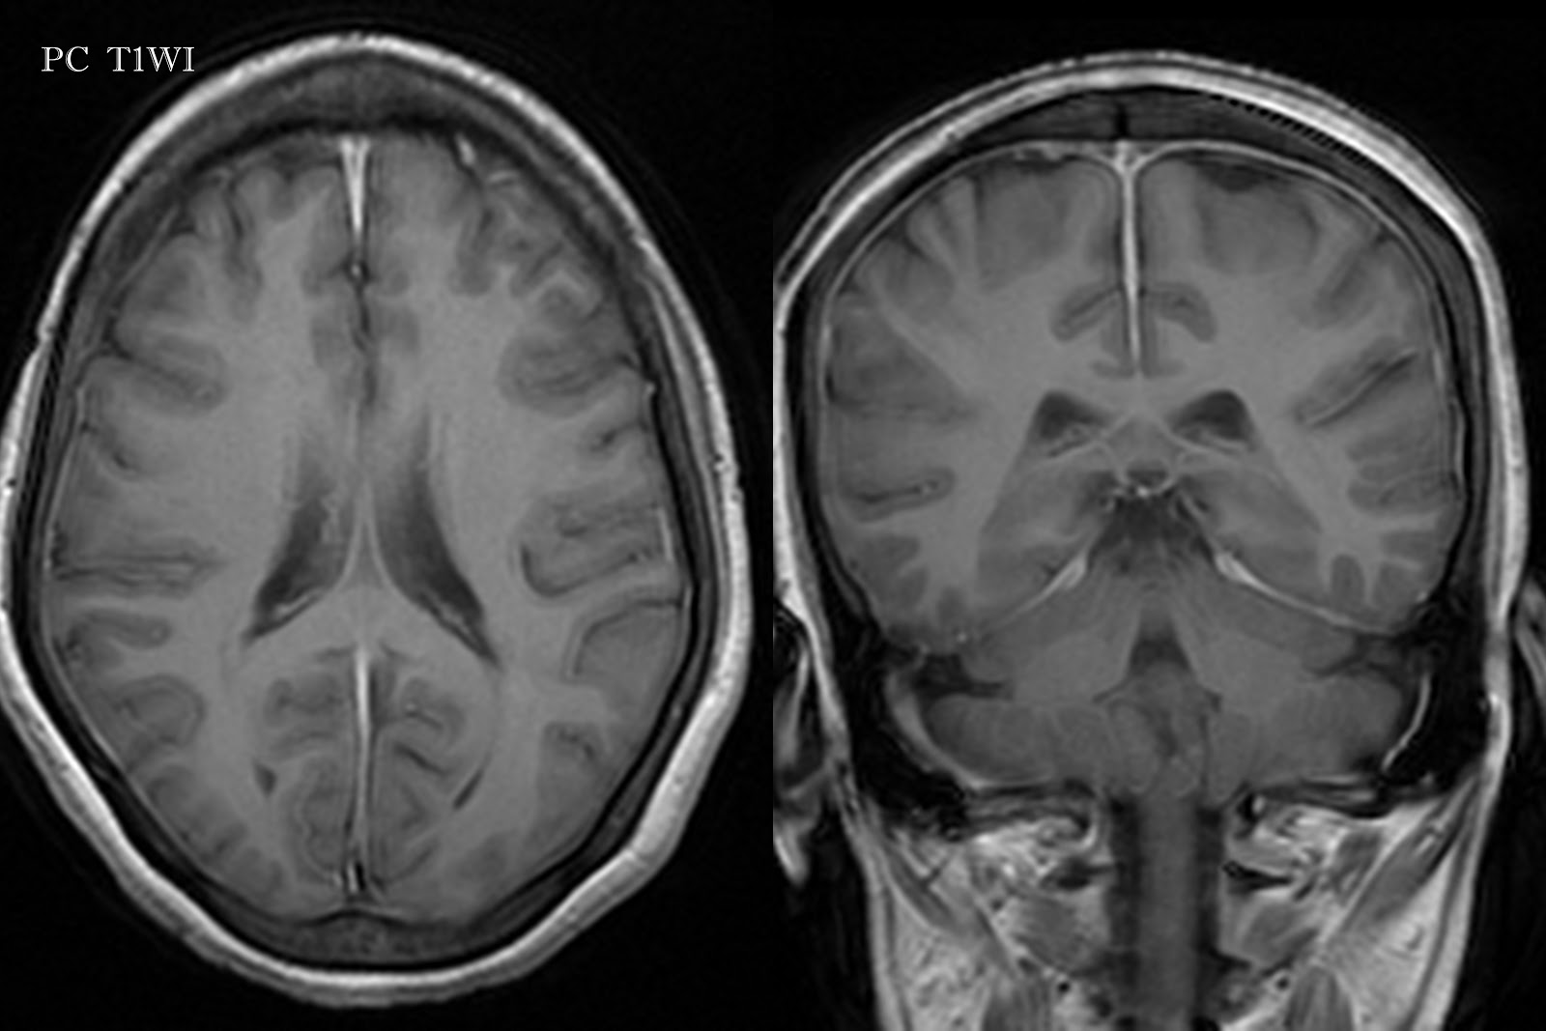
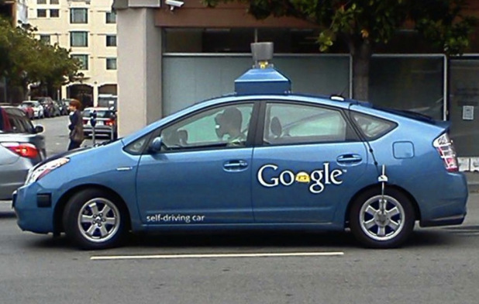
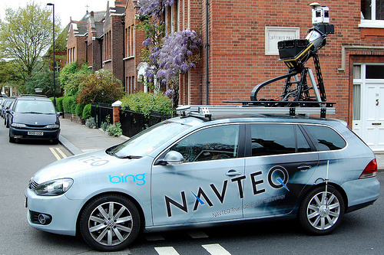
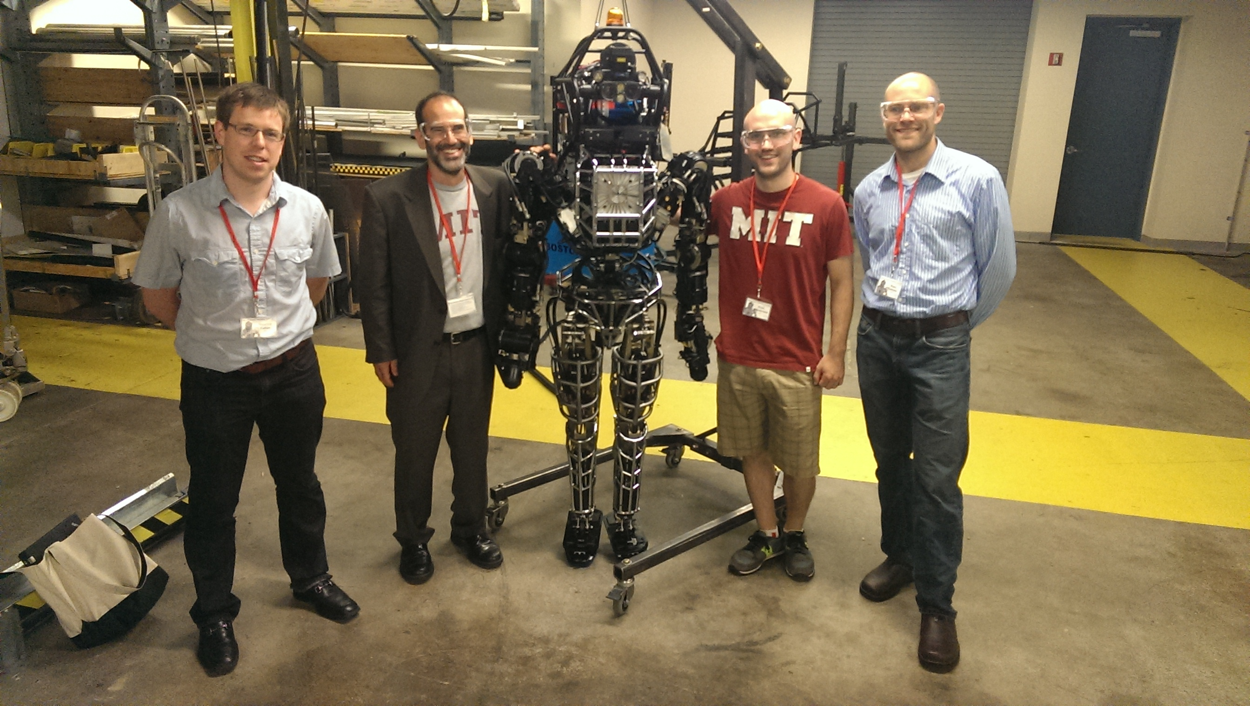
Bio-Imaging
Surveillance
Medical Imaging
Autonomous Cars
Mapping
Robotics
Social Media

Slide 13
Overview of the field
Conferences
Computer Vision
Computer Vision and Pattern Recognition (CVPR)
International Conference on Computer Vision (ICCV)
European Conference on Computer Vision (ECCV)
British Machine Vision Conference (BMVC)
Machine learning
Neural Information Processing Systems (NIPS)
International Conference on Machine Learning (ICML)
International Conference on Learning Representations (ICLR)

Slide 14
Overview of the field
Some metrics: checkout Google scholar on that, here!

Slide 15
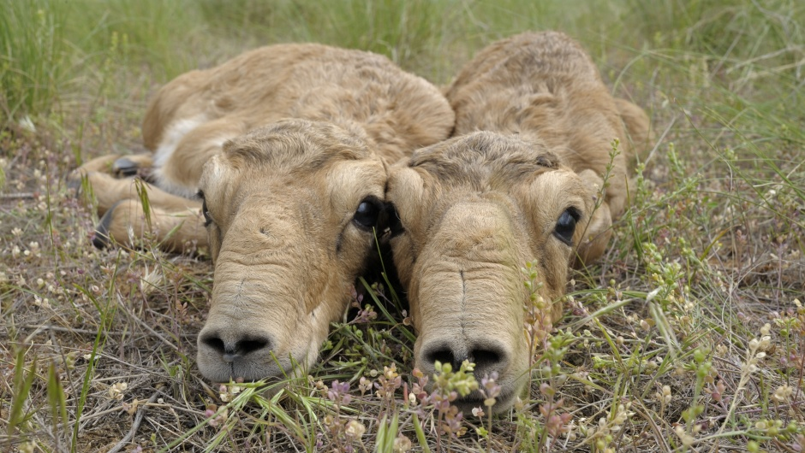
Typical vision problems
Recognition
“Saiga antilope”
Task: Label an image by its class membership

Slide 16
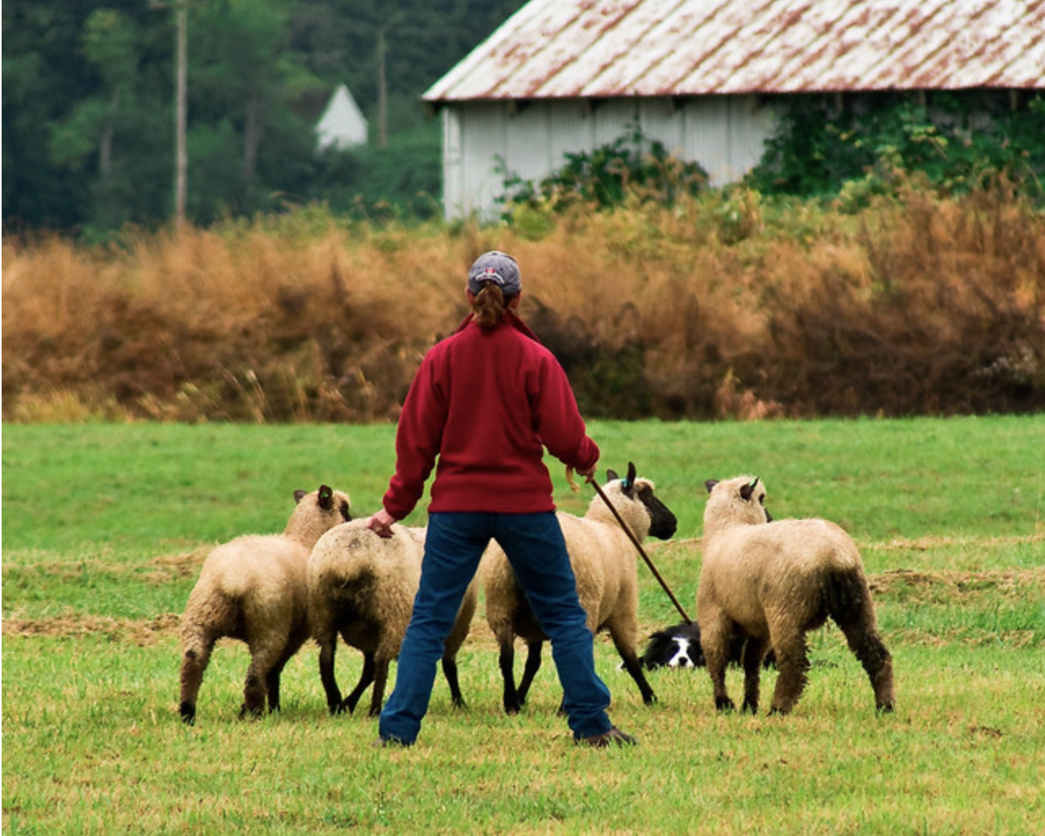

Typical vision problems
Segmentation
Task: Label each pixel of an image by its class membership.

Slide 17
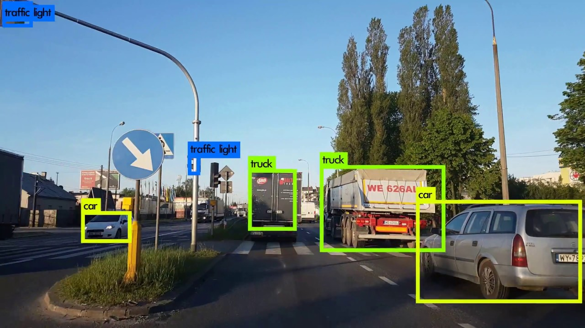
Typical vision problems
Detection
Task: Locate and label objects via, e.g., bounding boxes (i.e., coordinates)

Slide 18
Typical vision problems
Panoptic Segmentation
Image source: Kirillov et al., “Panoptic Segmentation”, In: CVPR ‘19
Semantic
segmentation
Instance
segmentation
Panoptic
segmentation
Goal: Unify semantic segmentation and instance segmentation.

Slide 19
Typical vision problems
Image-to-Image translation
Label map → Image
Arial → Map
BW → Color

Slide 20


Typical vision problems
Text-to-Image Generation
Prompt: An extremely angry bird.
Prompt: A photo of a Persian cat wearing sunglasses and a red shirt
skateboarding on a beach.
Image source: imagen.research.google

Slide 21
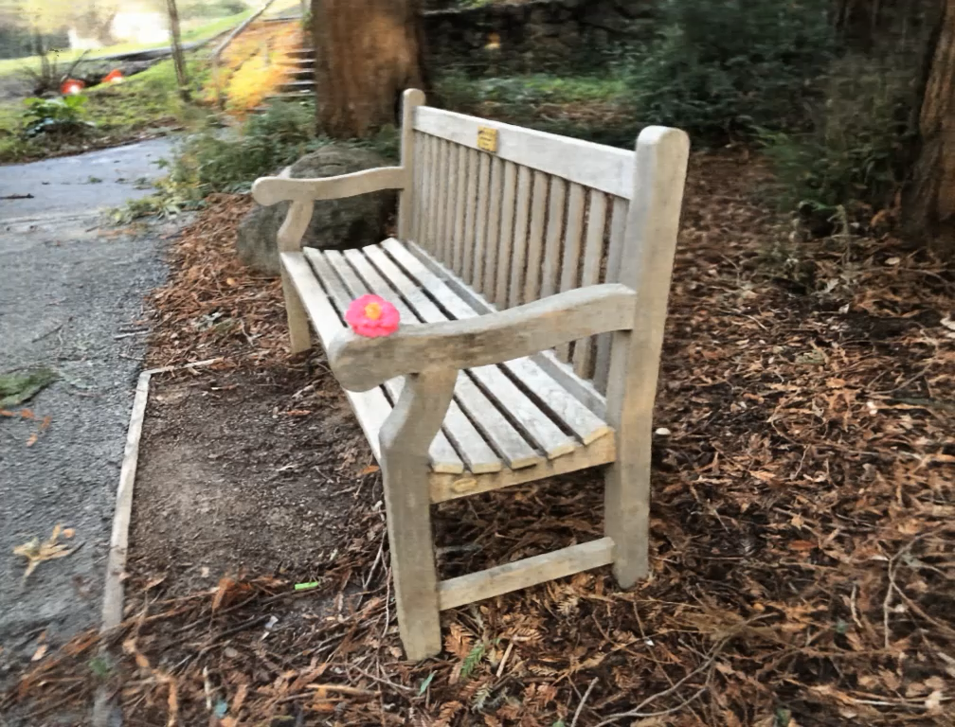
Typical vision problems
Synthesizing novel views
Video source: https://www.matthewtancik.com/nerf

Slide 22
Typical vision problems
Dalle-2 Demo (not publicly available, you need to sign up and get approved).

Slide 23
Some interesting resources
Browse D. H. Hubel’s online book (Nobel prize winner, 1981)
http://hubel.med.harvard.edu/book/bcontex.htm
Read one of his and Torsten Wiesel’s seminal papers, e.g.,
Receptive Fields and Functional Architecture of Monkey Striate Cortex,
D. H. Hubel and T. N. Wiesel
J. Physiol., 1968
http://www.ncbi.nlm.nih.gov/pubmed/4966457)

